Slide 1



C. Pro. Computer Info-tech Institute
INTEL MICROPROCESSORS
Under the guidance of:
Miss Neha Rai
Made by:
Abhishek Kumar Gupta

Slide 2

Introduction:
Intel Core is a line of mid- to high-end consumer, workstation, and enthusiast central processing units (CPU) marketed by Intel Corporation. These processors displaced the existing mid- to high-end Pentium processors of the time, moving the Pentium to the entry level, and bumping the Celeron series of processors to the low end. Identical or more capable versions of Core processors are also sold as Xeon processors for the server and workstation markets.
The first products receiving this designation were the Core Solo and Core Duo Yonah processors for mobile from the Pentium M design tree, fabricated at 65 nm and brought to market in January 2006. These are substantially different in design than the rest of the Intel Core product group, having derived from the Pentium Pro lineage that predated Pentium 4.

Slide 3
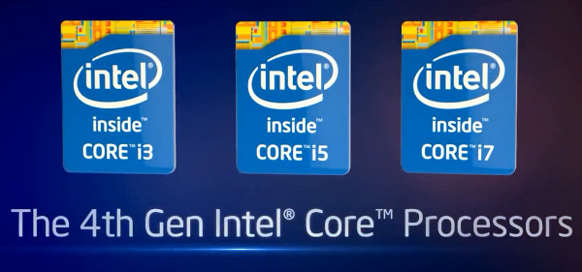
4th generation microprocessors:
Haswell is the4th Generation Core processor microarchitecture and was released in 2013. It uses 22nm chip.
S.No. | Code Name | Brand Name | No. of Cores | L3 Cache | GPU Model | Socket | Total Dispited power (watt) | Process of manufac -ture | I/O Bus | Release Date
01. | Haswell-E | Core i7 | 8 | 20MB | N/A | LGA 2011-3 | 140 W | 22nm | Direct Media Interface | september 2014
 |  | Core i7 | 6 | 15MB
02. | Haswell-DT | Core i7 | 4 | 8MB | HD-4600 | LGA 1150 | 84W | 22nm | Direct media Interface, Integrated GPU | June 2013
 |  | Core i7 |  |  |  |  | 65W
 |  | Core i7 |  |  |  |  | 45W
 |  | Core i7 |  |  | IRIS PRO 5200 |  | 35W

Slide 4
S.No. | Code Name | Brand Name | No. of Cores | L3 Cache | GPU Model | Socket | Total Dispited power (watt) | Process of manufac -ture | I/O Bus | Release Date
03. | Haswell-DT | Core i5 | 4 | 6MB | HD-4600 | LGA 1150 | 84W | 22nm | Direct media Interface, Integrated GPU | June 2013
 |  | Core i5 |  |  |  |  | 65W
 |  | Core i5 |  |  |  |  | 45W
 |  | Core i5 | 2 | 4MB | IRIS PRO 5200 |  | 35W
 |  | Core i5 | 4 |  |  | BGA 1364 | 65W
04. | Haswell-DT | Core I3 | 2 | 4MB | HD-4600 | LGA 1150 | 54W | 22nm | Direct media Interface, Integrated GPU | September 2013
 |  | Core I3 |  |  |  |  | 35W
 |  | Core I3 |  |  | HD-4400 |  | 54W
 |  | Core I3 |  |  |  |  | 35W

Slide 5
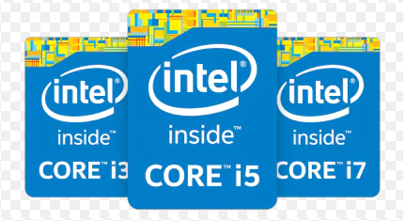
5th generation microprocessors:
Broadwell is the 5th Generation Core Processor microarchitecture and was released by Intel in september 2014. It is the first to use 14nm chip. Additionally, Mobile processors were launched in january 2015 and Desktop core i5 and i7 processors were released in june 2015.
S.No. | Code Name | Brand Name | No. of Cores/ Threads | L3 Cache | GPU Model | Socket | Total Dispited power (watt) | Process of manufac -ture | I/O Bus | Release Date
01. | Broadwell-E | Core i7 | 6/12 | 15MB | N/A | LGA 2011-3 | 140 W | 14nm | Direct Media Interface | 2016
 |  | Core i7 | 8/16 | 20MB
 |  | Core i7 | 10/20 | 25MB

Slide 6
S.No. | Code Name | Brand Name | No. of Cores/ Threads | L3 Cache | GPU Model | Socket | Total Dispited power (watt) | Process of manufac -ture | I/O Bus | Release Date
02. | Broadwell-DT | Core i7 | 4/8 | 6MB | IRIS 6200 | LGA 1150 | 65W | 14nm | Direct media Interface, Integrated GPU | June 2015
 |  | Core i7
03. | Broadwell-DT | Core i5 | 4/4 | 4MB | IRIS 6200 | LGA 1150 | 65W | 14nm | Direct media Interface, Integrated GPU | June 2013
 |  | Core i5
 |  | Core i5

Slide 7
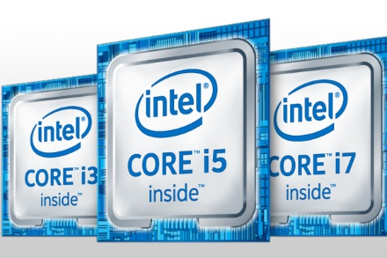
6th generation microprocessors:
Skylake is the sixth generation Core processor microarchitecture, and was launched in August 2015. Being the successor to the Broadwell line, it is a redesign using the same 14 nm manufacturing process technology; however the redesign has better CPU and GPU performance and reduced power consumption.
S.No. | Code Name | Brand Name | No. of Cores/ Threads | L3 Cache | GPU Model | Socket | Total Dispited power (watt) | Process of manufac -ture | I/O Bus | Release Date
01. | Skylake-DT | Core i7 | 4/8 | 8MB | HD 530 | LGA 1151 | 65W | 14nm | Direct media Interface, Integrated GPU | September 2015
 |  | Core i7 |  |  |  |  | 35W
 |  | Core i7 |  |  |  |  | 91W |  |  | August 2015
 |  | Core i7
 |  |  |  |  | IRIS PRO 580 |  | 65W |  |  | May 2016

Slide 8
S.No. | Code Name | Brand Name | No. of Cores/ Threads | L3 Cache | GPU Model | Socket | Total Dispited power (watt) | Process of manufac -ture | I/O Bus | Release Date
02. | Skylake-DT | Core i5 | 4/8 | 6MB | HD 530 | LGA 1151 | 65W | 14nm | Direct media Interface, Integrated GPU | September 2015
 |  | Core i5
 |  | Core i5
 |  | Core i5 |  |  |  |  | 91W
 |  | Core i5 |  |  |  |  | 35W
 |  | Core i5 |  |  |  |  |  |  |  | June 2015
 |  | Core i5 |  |  | HD 510 |  | 65W |  |  | December 2015
03. | Skylake-DT | Core i3 | 2/4 | 3MB | HD-510 | LGA 1151 | 54W | 14nm | Direct media Interface, Integrated GPU | December 2015
 |  | Core i3 |  |  | HD-530 |  | 51W |  |  | September 2015
 |  | Core i3 |  |  |  |  | 35W
 |  | Core i3 |  | 4MB |  |  | 51W
 |  | Core i3
 |  | Core i3 |  |  |  |  | 35W

Slide 9
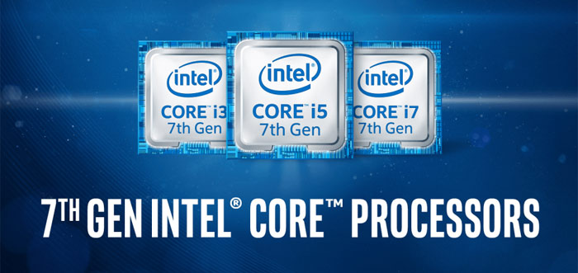
7th generation microprocessors:
Kaby Lake is the seventh generation Core processor microarchitecture, and was launched in January 2017.Built on an improved 14 nm process, Kaby Lake features faster CPU clock speeds and Turbo frequencies.
S.No. | Brand Name | No. of Cores/ Threads | L3 Cache | CPU Clock Rate (GHz) | Turbo Clock Rate (GHz) | GPU Model | Max GPU Clock Rate (MHz) | Total Dispited power (watt) | PRICE (USD)
01. | Core i7 | 4/8 | 8MB | 4.2 | 4.4 | HD 630 | 1150 | 91W | $ 350
 | Core i7 |  |  | 3.6 | 4.0 |  |  | 65W | $ 312
 | Core i7 |  |  | 2.9 | 3.6 |  |  | 35W

Slide 10
S.No. | Brand Name | No. of Cores/ Threads | L3 Cache | CPU Clock Rate (GHz) | Turbo Clock Rate (GHz) | GPU Model | Max GPU Clock Rate (MHz) | Total Dispited power (watt) | PRICE (USD)
02. | Core i5 | 4/4 | 6MB | 3.8 | 4.0 | HD630 | 1150 | 91W | $ 243
 | Core i5 |  |  | 3.5 | 3.9 |  |  | 65W | $ 224
 | Core i5 |  |  | 2.8 | 3.5 |  | 1100 | 35W
 | Core i5 |  |  | 3.4 | 3.6 |  |  | 65W | $ 202
 | Core i5 |  |  | 2.7 | 3.1 |  |  | 35W
 | Core i5 |  |  | 3.0 | 3.3 |  | 1000 | 65W | $ 182
 | Core i5 |  |  | 2.4 | 2.7 |  |  | 35W | $ 187
03. | Core i3 | 2/4 | 4MB | 4.2 | N/A | HD630 | 1150 | 60W | $ 179
 | Core i3 |  |  | 4.1 |  |  |  | 51W | $ 157
 | Core i3 |  |  | 4.0 |  |  |  |  | $ 147
 | Core i3 |  |  | 3.5 |  |  | 1100 | 35W
 | Core i3 |  |  | 3.9 |  |  |  | 51W | $ 117
 | Core i3 |  |  | 3.4 |  |  |  | 35W
 | Core i3 |  |  | 3.9 |  |  |  | 54W
 | Core i3 |  |  | 3.4 |  |  |  | 35W

Slide 11
S.No. | Brand Name | No. of Cores/ Threads | L3 Cache | CPU Clock Rate (GHz) | Turbo Clock Rate (GHz) | GPU Model | Max GPU Clock Rate (MHz) | Total Dispited power (watt) | PRICE (USD)
04. | pentium | 2/4 | 3MB | 3.7 | N/A | HD630 | 1100 | 51W | $ 93
 | pentium |  |  | 3.6 |  |  |  |  | $ 82
 | pentium |  |  | 3.0 |  |  | 1050 | 35W | $ 75
 | pentium |  |  | 3.5 |  | HD610 |  | 54W | $ 64
 | pentium |  |  | 2.9 |  |  |  | 35W
05. | celeron | 2/2 | 2MB | 3.0 | N/A | HD610 | 1050 | 51W | $ 52
 | celeron |  |  | 2.9 |  |  |  |  | $ 42
 | celeron |  |  | 2.7 |  |  | 1000 | 35W

Slide 12
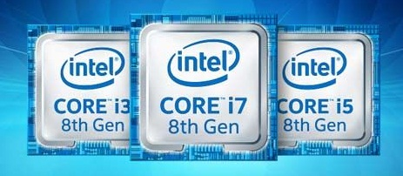
8th generation microprocessors:
Coffee Lake is the eighth generation Intel Core micro-architecture and was launched in October 2017. For the first time in the ten year history of Intel Core processors, the Coffee Lake generation features an increase in core counts.
S.No. | Brand Name | No. of Cores/ Threads | L3 Cache | CPU Clock Rate (GHz) | Turbo Clock Rate (GHz) | GPU Model | Max GPU Clock Rate (MHz) | Total Dispited power (watt) | PRICE (USD)
01. | Core i7 | 4/8 | 8MB | 4.2 | 4.4 | HD 630 | 1150 | 91W | $ 350
 | Core i7 |  |  | 3.6 | 4.0 |  |  | 65W | $ 312
 | Core i7 |  |  | 2.9 | 3.6 |  |  | 35W

Slide 13
S.No. | Brand Name | No. of Cores/ Threads | L3 Cache | CPU Clock Rate (GHz) | Turbo Clock Rate (GHz) | GPU Model | Max GPU Clock Rate (MHz) | Total Dispited power (watt) | PRICE (USD)
02. | Core i5 | 4/4 | 6MB | 3.8 | 4.0 | HD630 | 1150 | 91W | $ 243
 | Core i5 |  |  | 3.5 | 3.9 |  |  | 65W | $ 224
 | Core i5 |  |  | 2.8 | 3.5 |  | 1100 | 35W
 | Core i5 |  |  | 3.4 | 3.6 |  |  | 65W | $ 202
 | Core i5 |  |  | 2.7 | 3.1 |  |  | 35W
 | Core i5 |  |  | 3.0 | 3.3 |  | 1000 | 65W | $ 182
 | Core i5 |  |  | 2.4 | 2.7 |  |  | 35W | $ 187
03. | Core i3 | 2/4 | 4MB | 4.2 | N/A | HD630 | 1150 | 60W | $ 179
 | Core i3 |  |  | 4.1 |  |  |  | 51W | $ 157
 | Core i3 |  |  | 4.0 |  |  |  |  | $ 147
 | Core i3 |  |  | 3.5 |  |  | 1100 | 35W
 | Core i3 |  |  | 3.9 |  |  |  | 51W | $ 117
 | Core i3 |  |  | 3.4 |  |  |  | 35W
 | Core i3 |  |  | 3.9 |  |  |  | 54W
 | Core i3 |  |  | 3.4 |  |  |  | 35W

Slide 14
S.No. | Brand Name | No. of Cores/ Threads | L3 Cache | CPU Clock Rate (GHz) | Turbo Clock Rate (GHz) | GPU Model | Max GPU Clock Rate (MHz) | Total Dispited power (watt) | PRICE (USD)
04. | Pentium Gold | 2/4 | 3MB | 3.7 | N/A | HD630 | 1100 | 51W | $ 93
 | Pentium Gold |  |  | 3.6 |  |  |  |  | $ 82
 | Pentium Gold |  |  | 3.0 |  |  | 1050 | 35W | $ 75
 | Pentium Gold |  |  | 3.5 |  | HD610 |  | 54W | $ 64
 | Pentium Gold |  |  | 2.9 |  |  |  | 35W
05. | celeron | 2/2 | 2MB | 3.0 | N/A | HD610 | 1050 | 51W | $ 52
 | celeron |  |  | 2.9 |  |  |  |  | $ 42
 | celeron |  |  | 2.7 |  |  | 1000 | 35W

Slide 15
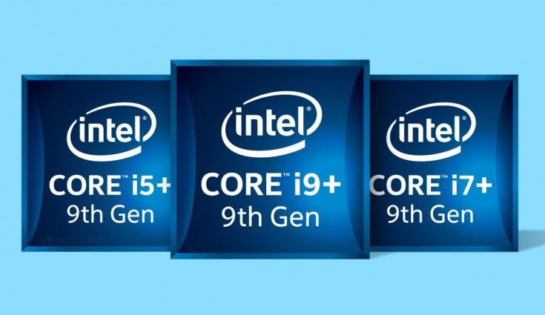
9th generation microprocessors:
The 9th generation Coffee Lake CPUs were released in the fourth quarter of 2018.For the first time in Intel consumer CPU history, these CPUs support up to 128GB RAM.
S.No. | Brand Name | No. of Cores/ Threads | L3 Cache | CPU Clock Rate (GHz) | Turbo Clock Rate (GHz) | GPU Model | Max GPU Clock Rate (GHz) | Total Dispited power (watt) | PRICE (USD)
01. | Core i9 | 8/16 | 16MB | 3.6 | 5.0 | UHD 630 | 1.20 | 95W | $ 488
 | Core i9 |  |  |  |  | N/A | N/A
02. | Core i7 | 8/8 | 12MB | 3.6 | 4.9 | UHD 630 | 1.20 | 95W | $ 374
 | Core i7 |  |  |  |  | N/A | N/A

Slide 16
S.No. | Brand Name | No. of Cores/ Threads | L3 Cache | CPU Clock Rate (GHz) | Turbo Clock Rate (GHz) | GPU Model | Max GPU Clock Rate (GHz) | Total Dispited power (watt) | PRICE (USD)
03. | Core i5 | 6/6 | 9MB | 3.7 | 4.6 | UHD 630 | 1.15 | 95W | $ 262
 | Core i5 |  |  |  |  | N/A | N/A
 | Core i5 |  |  | 2.9 | 4.1 | UHD 630 | 1.05 | 65W | $ 182
 | Core i5 |  |  |  |  | N/A | N/A
04. | Core i3 | 4/4 | 8MB | 4.0 | 4.6 | N/A | N/A | 91W | $ 173

Slide 17
Bibliography:
This is where I have listed the develpoment and a series of microprocessors for computer.It shows the step by step development and advancement of technology.
At last it shows the feature and compacting designs of various micoprocessor generation after generation as per the need of advancing and racing technology.
Abhishek Kumar Gupta
OMC (9:00-12:00)

